Slide 1
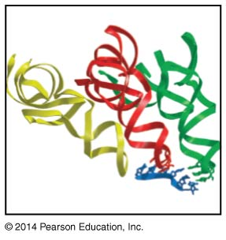
Translation
BT 454
Chapter 15

Slide 2
Translation
Most conserved among species
80% of cell energy dedicated for protein synthesis
Components for translation
  mRNA
  tRNA
  Aminoacyl tRNA synthetase
  Ribosome
Notes:
The codon in mRNA can not interact in a very accurate way with the amino acid aromatic rings therefore there must be an adapter that interact so accurately with mRNA and at the same time act as adaptor between it and the amino acids, which is tRNA

Slide 3
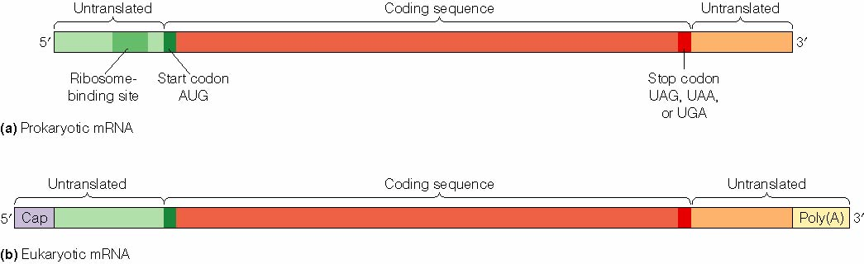
1- mRNA
  Start codon
    Prokaryotes 5`-AUG-3`, 5`GUG-3`, 5`-UUG-3`
    Eukaryotes 5`-AUG-3`
  Stop codon
    5`-UAG-3`, 5`UGA-3`, 5`-UAA-3`

Slide 4
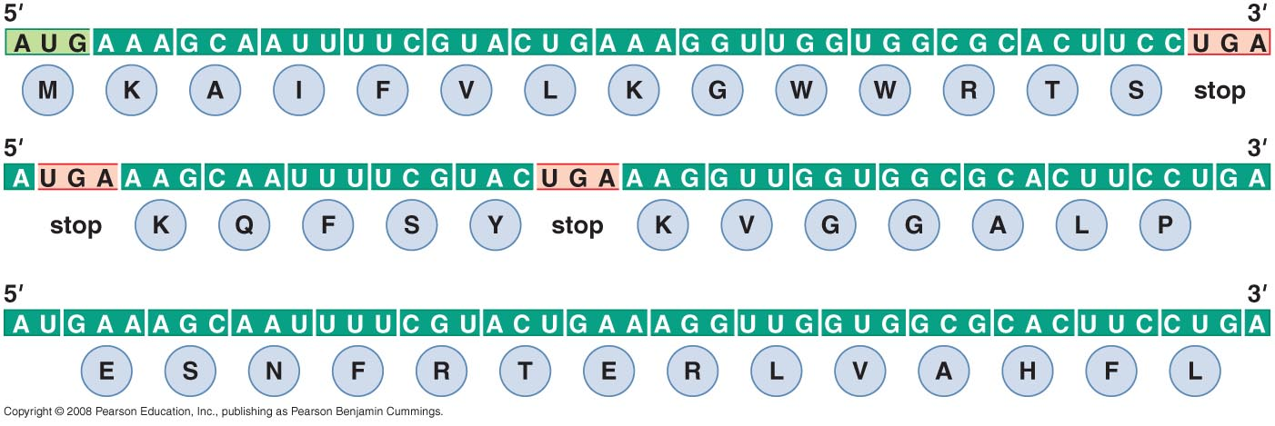
Open reading frames (ORF)
  protein coding region
  contiguous non-overlapping string of codons
  Starts with start codon
  Ends with stop codon
  Prokaryotic mRNA usually contains 2-3 ORF while Eukaryotes have one

Slide 5
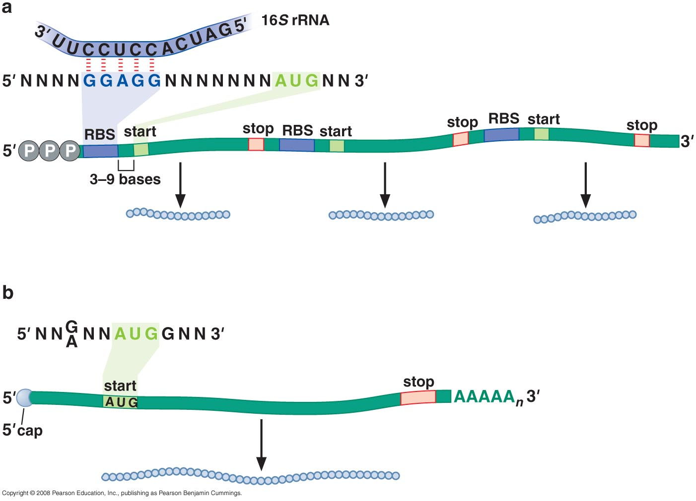
Polycistronic Vs monocistronic mRNA

Slide 6
Effective translation
Prokaryotes
  spacing between RBS (Shine-dalgarno) and start site
  complementarity between 16SrRNA and RBS
  Translational coupling
Eukaryotes
  Presence of 5` cap
  Presence of Kozak sequence (5`-G/ANNAUGG-3`)
  Presence of poly A tail
Notes:
How often is a particular ORF is translated depends on:
1- spacing between RBS and start site
2- extent of complementarity between 16SrRNA and RBS
3- if start codon is close to stop codon of next gene, it will be actively translated even if it lacks a strong RBS (translational coupling)
In prokaryotes kozak sequence is essential to interact with intiating tRNA not in interaction with rRNA

Slide 7
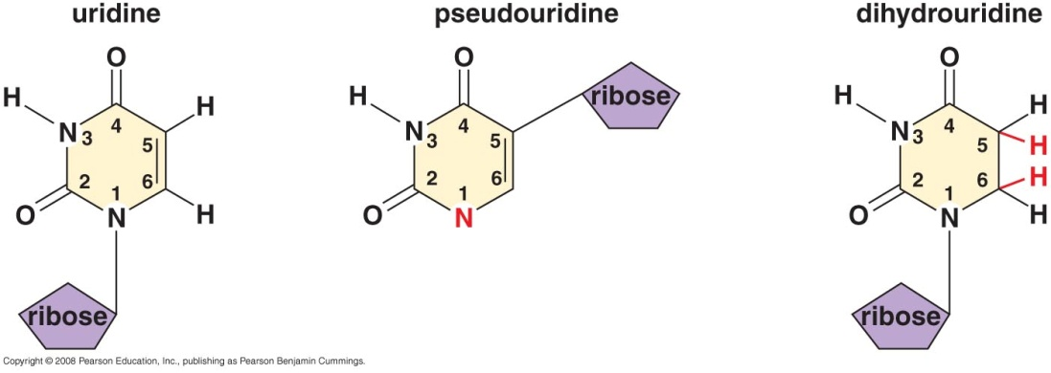
2- tRNA
Most tRNA recognize more than one codon
~ 75-95 ribonucleotide with different sequence
All tRNA ends with 5`-CCA-3` at 3` end added by CCA adding enzyme (synthesizing enzyme without a template)
Includes unusual bases in primary structure
  Pseudouridine (ψ U), Dihydrouridine (D)
  Hypoxanthine, thymine, methylguanine
Notes:
These unusual bases were modified after being transcribed
These modifications are not essential for tRNA function but if not present it may reduce tRNA activity (hypoxanthin helps in codon recognition by certain tRNA
Cells with unmodified tRNA shows reduced rate of growth

Slide 8
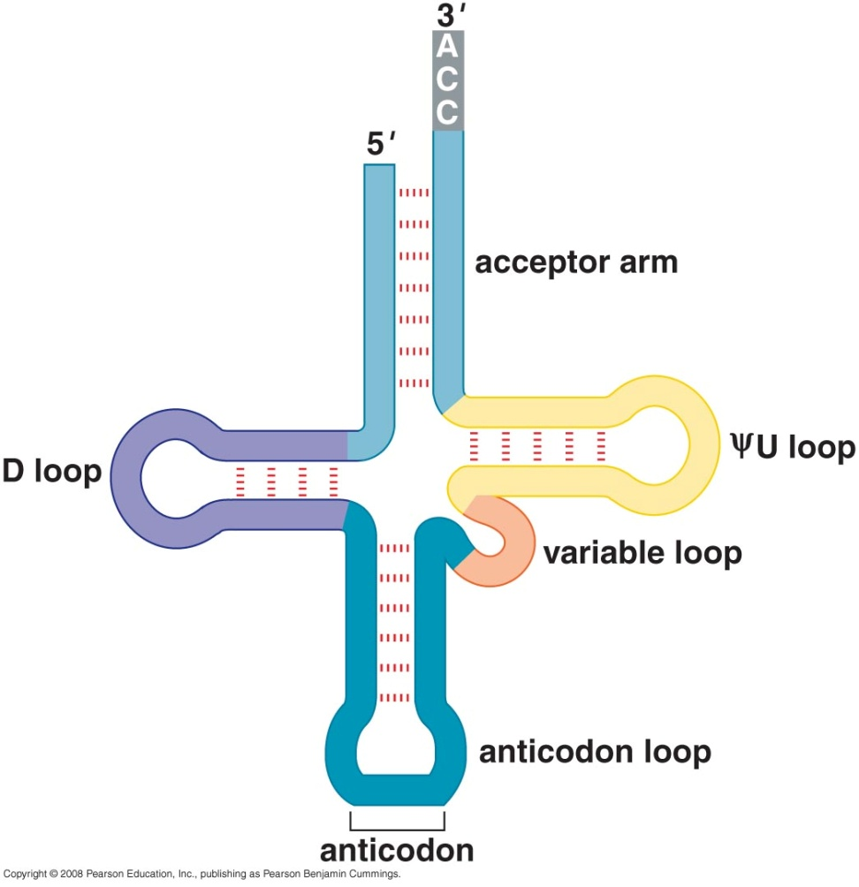
tRNA secondary structure
Cloverleaf shape secondary structure
  Acceptor stem
  ΨU loop
  D loop (dihydrouridine)
  Anticodon loop
  Variable loop (~ 3-21bp)
Notes:
Acceptor stem, three stem-loops (ΨU, D, anticodon, variable)

Slide 9
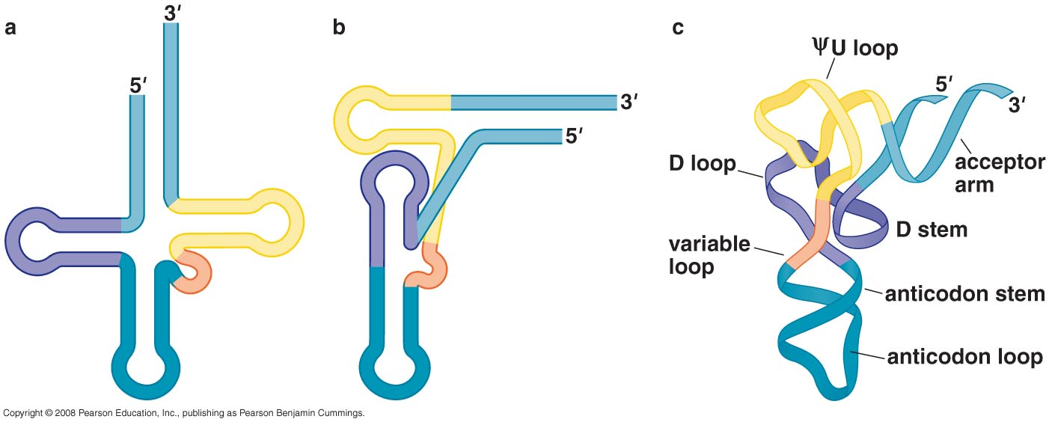
tRNA tertiary structure
Stabilizing interactions:
  Hydrogen bonds between bases (unconventional)
  Interaction between bases & sugar phosphate backbone
  Base stacking
Notes:
Acceptor stem, three stem-loops (ΨU, D, anticodon, variable)

Slide 10
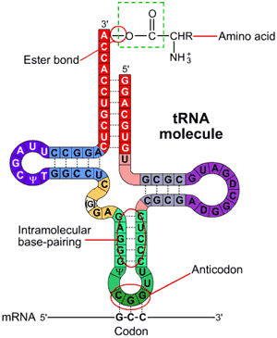
Attachment of amino acids to tRNA
Charged tRNA
Acyl linkage of a.a carboxyl group & 2` or 3` of adinosine hydroxyl group
High energy bond
Aminoacyl tRNA Synthetase enzyme
Occurs in two steps

Slide 11
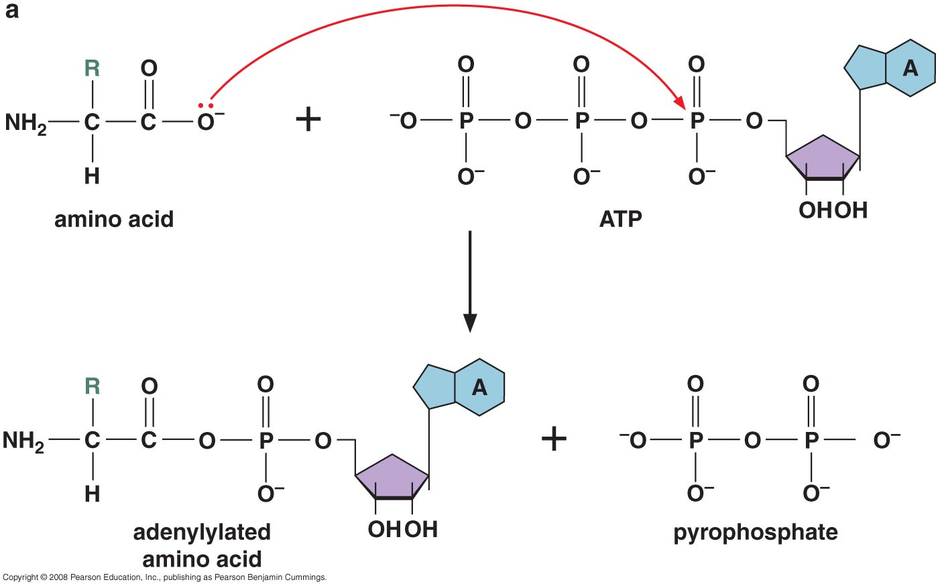
Step 1: adenylylation
Notes:
Adenylation reaction AMP is added and pyrophosphate results but the adenosine is what interact with T by 2 hydrogen bonds and the P interact with backbone of DNA, while in polyadenylylation the phosphate is what interact with aa not the adenine resulting in adenylic acid and a pyrophosphate again results
High energy ester bond between carboxyl group of aa and phosphoryl group of AMP

Slide 12
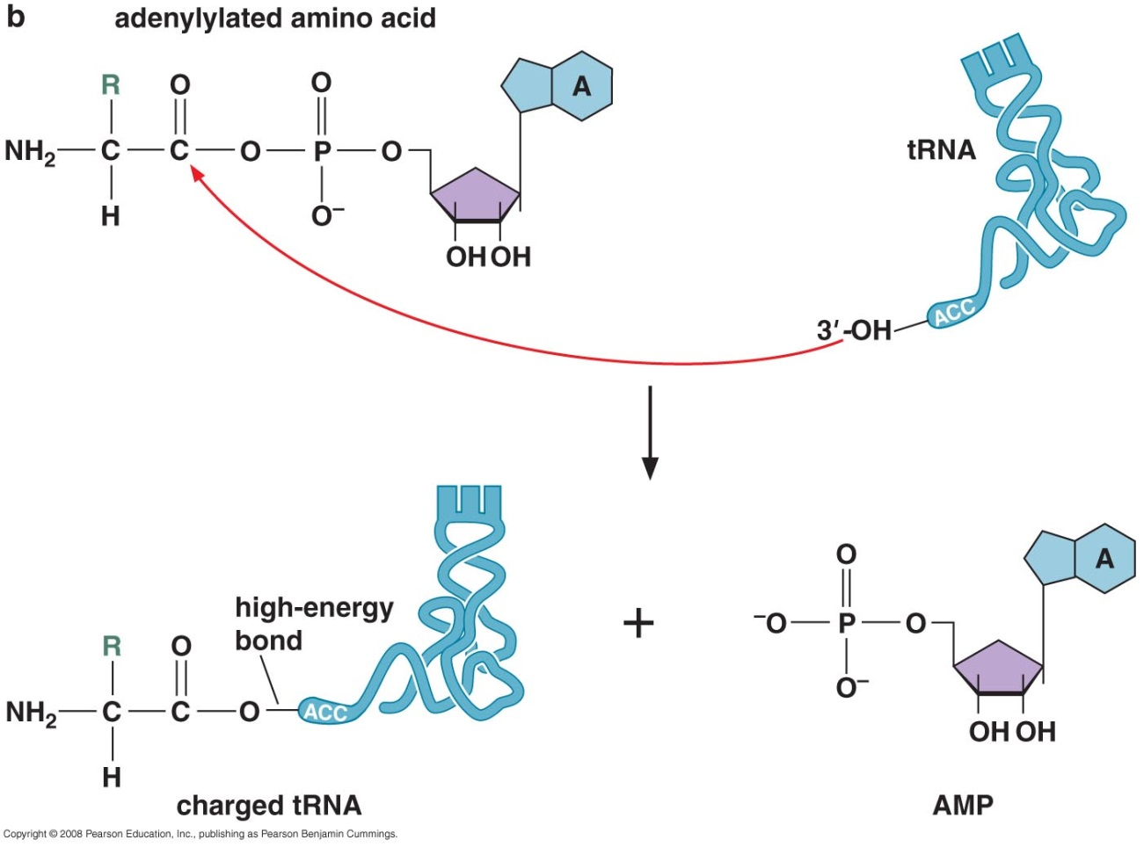
Step 2: tRNA charging
Synthetase enz.
  Class I
    Attach aa to 2`OH
  Class II
    Attach aa to 3`OH

Slide 13
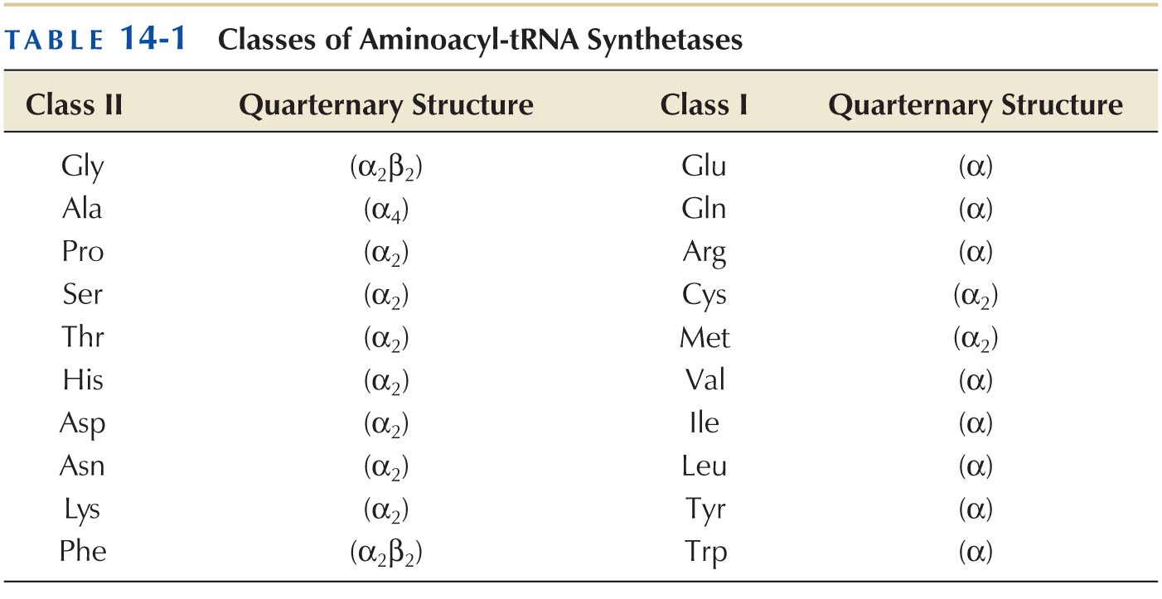
Classes of Synthetase Enzymes

Slide 14
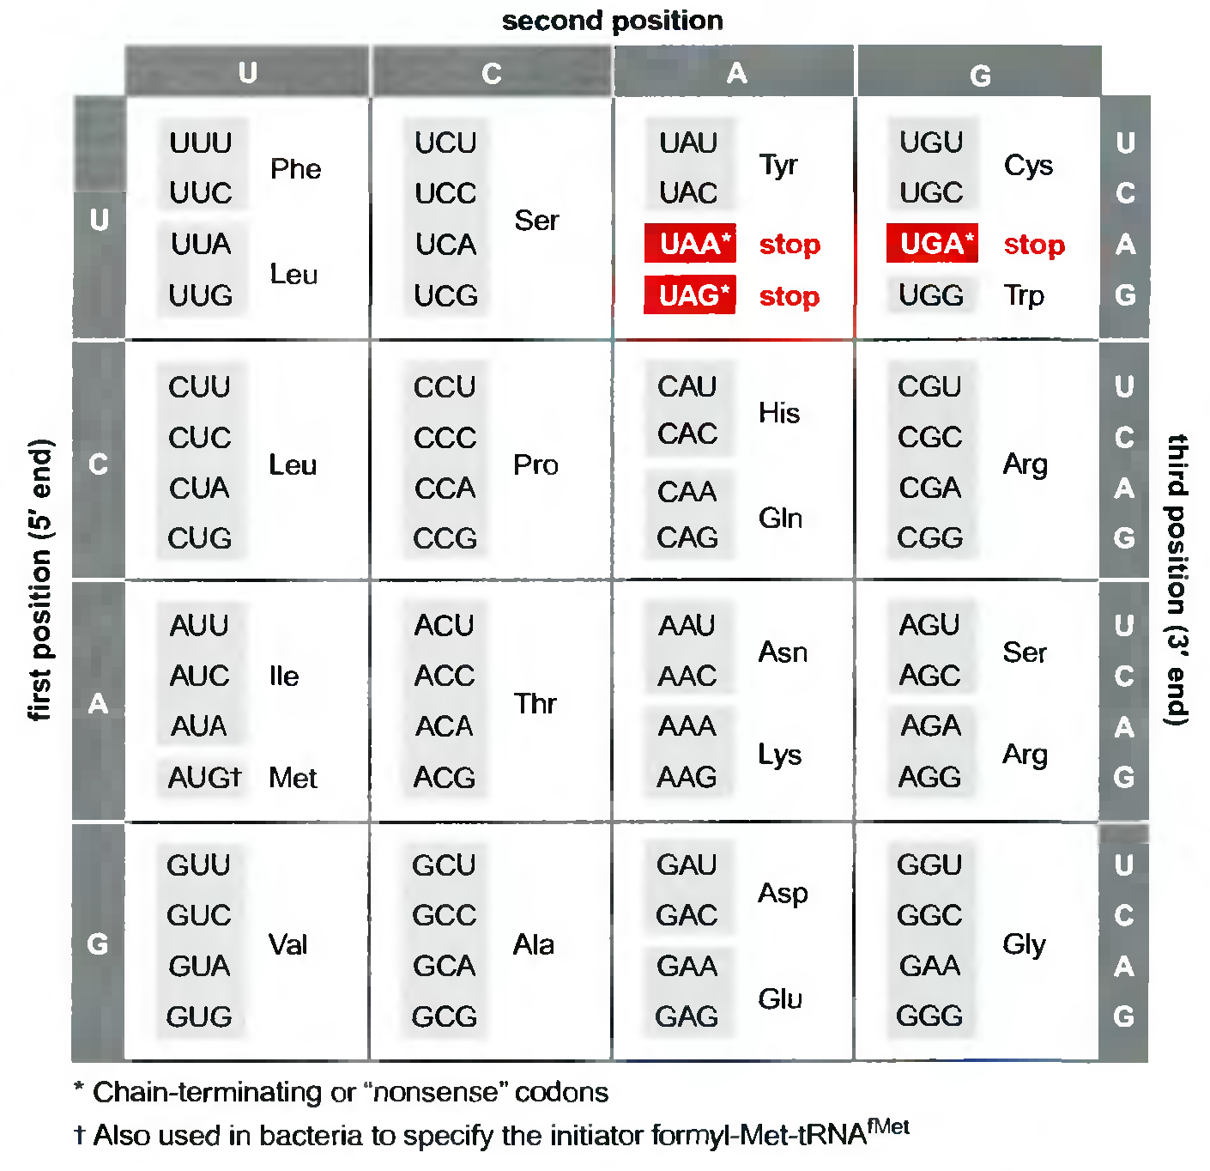
Each synthetase attach single amino acid
One synthetase charge tRNA with ONLY one amino acid (20 tRNA synthetase)
One synthetase recognize more than one tRNA
Isoaccepting tRNA
Gln-tRNA^{Gln}
a.a
Anti codon-tRNA
Notes:
Some bacteria lack glutamate synthase and therefore uses glutamine synthase to load glutamate so Gln tRNA ^{Gln} then another enzyme is used to deaminate Gln and convert it to Glu

Slide 15
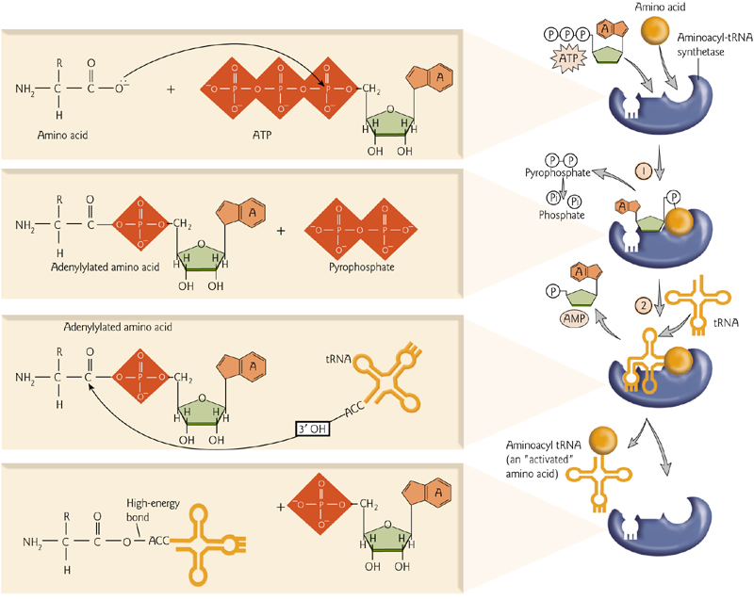

Slide 16
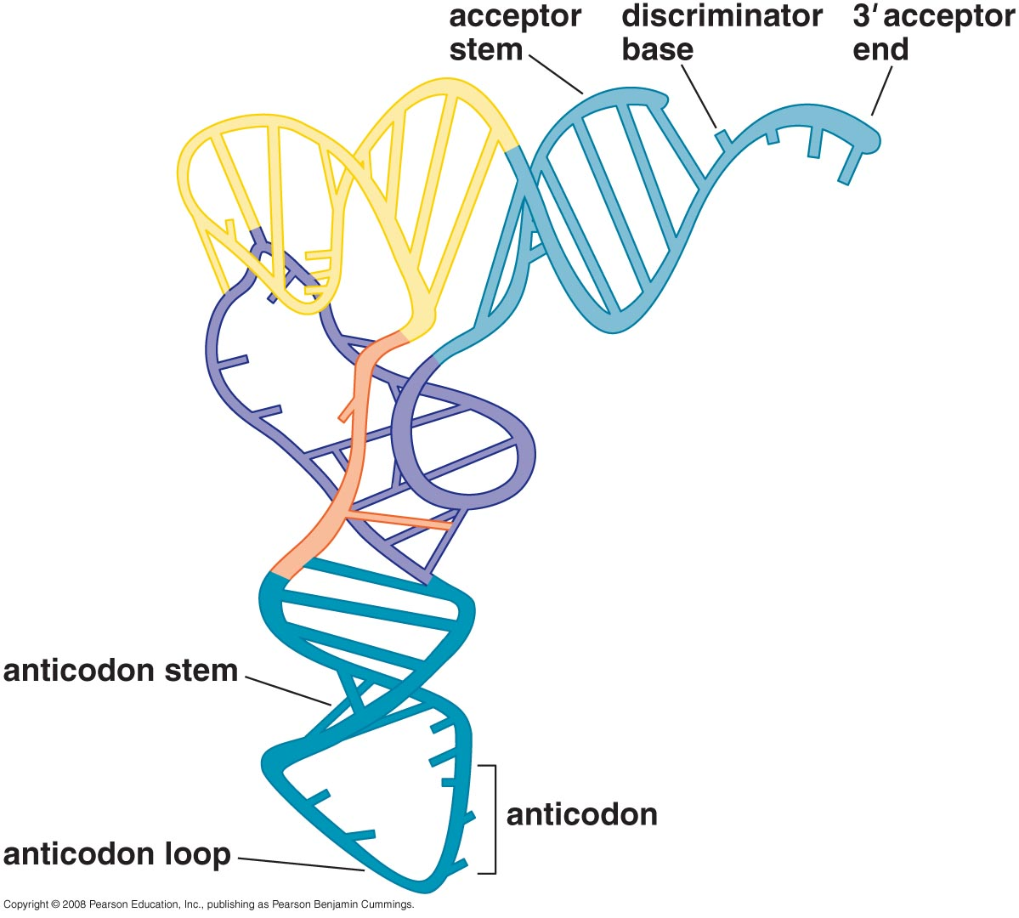
How can a synthetase recognize isoaccepting tRNA

Slide 17
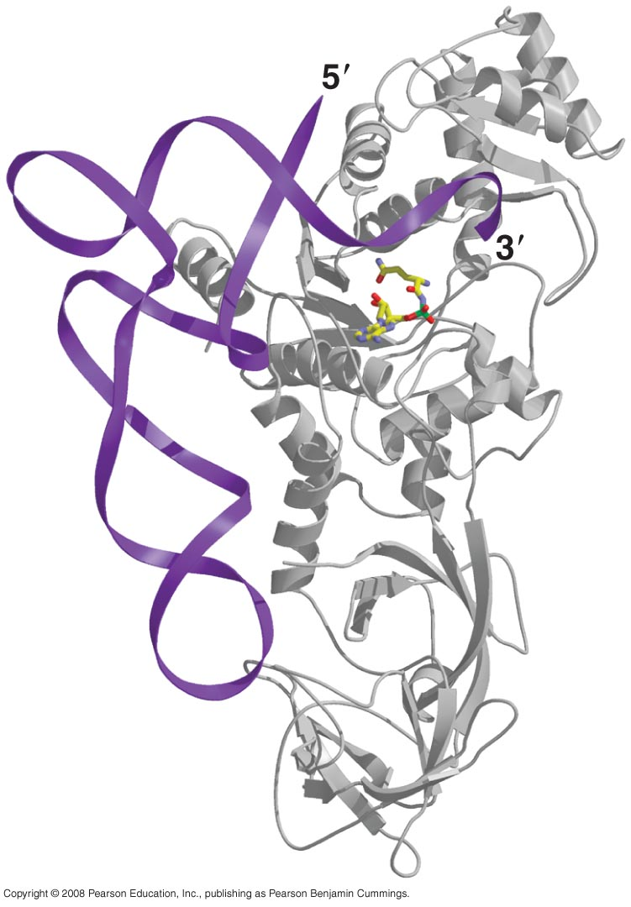
Challenge I: recognizing correct isoaccepting tRNA
Several anticodons specify one amino acid
6 codons for serine (AGC, UCA)
More complex Second genetic code

Slide 18
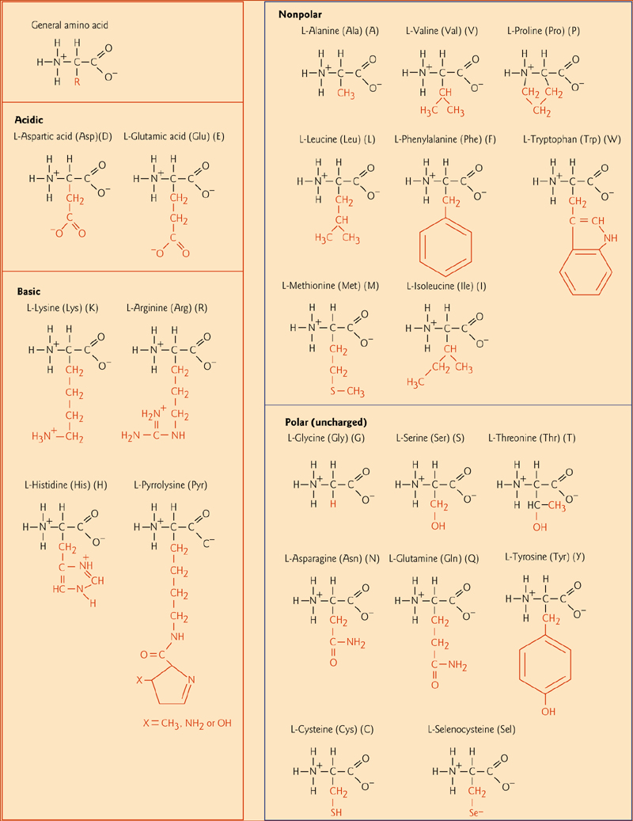
Challenge II: recognizing the correct amino acid

Slide 19
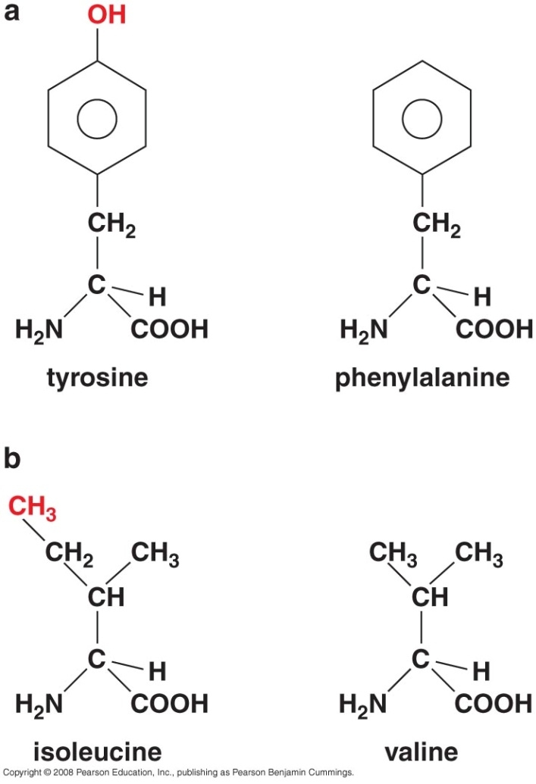
Challenge II: recognizing the correct amino acid
Small size of amino acids
Some a.a have similar structure
Ways of discrimination:
  OH group
    Stronger H-bonds
  Size
    To fit in catalytic pocket
Error rate less than 1 in 1000

Slide 20

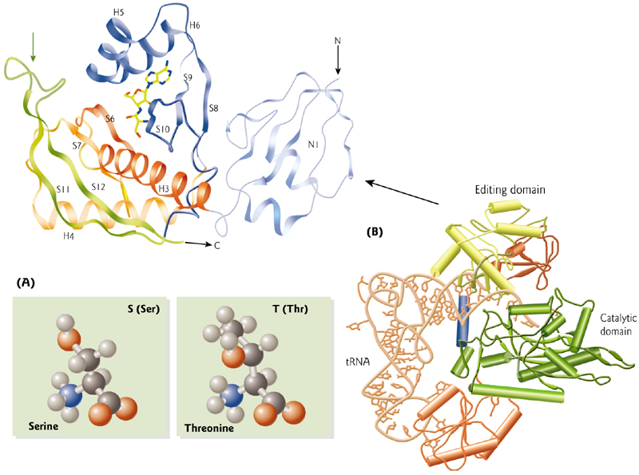
Challenge II: recognizing the correct amino acid
fitting in the catalytic site will allow aa to be adenylylated (AMP-aa)
editing site allows adenylylated aa to get through if it has a suitable size to get through the to be hydrolyzed (aa+AMP) (2nd proofreading)
Accuracy level is 100X100=10.000
Notes:
The first

Slide 21
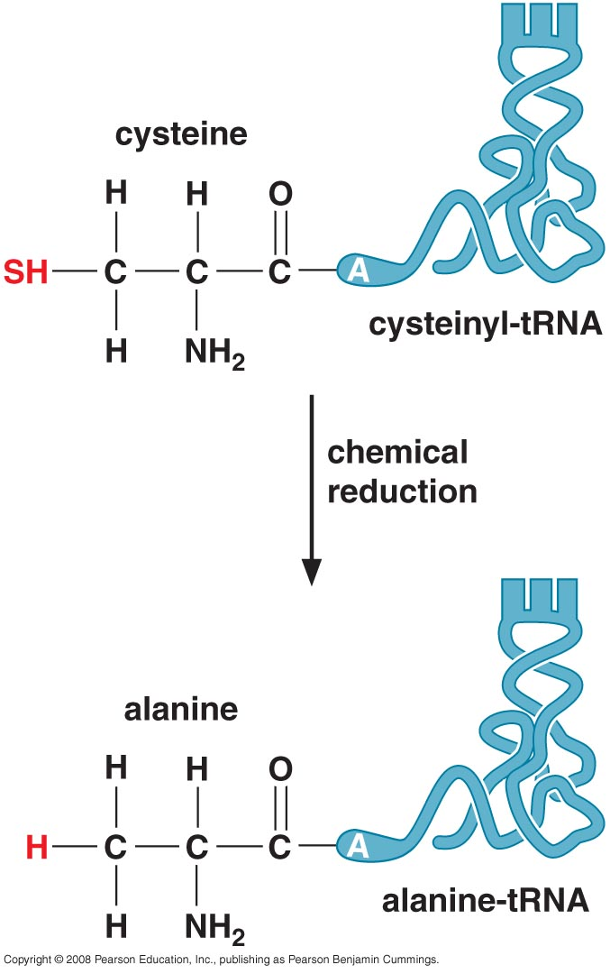
Aminoacyl tRNA synthetase are responsible for accurate aa loading to tRNA
Ribosome only check correct codon-anticodon relationship
Genetic evidence
Biochemical experiment
Notes:
1- genetic evidence that mutated tRNA (mutated anti codon) would not normally affect attaching correct aa to tRNA because aatRNA synthetase relies on geomtric features rather than anti codon sequence, so tRNA is attached to correct aa but during translation, the mutated anticodon will bind to matched codon (which is in fact not the correct match for that aa) of course ribosome will not notice that
2- biochemical

Slide 22
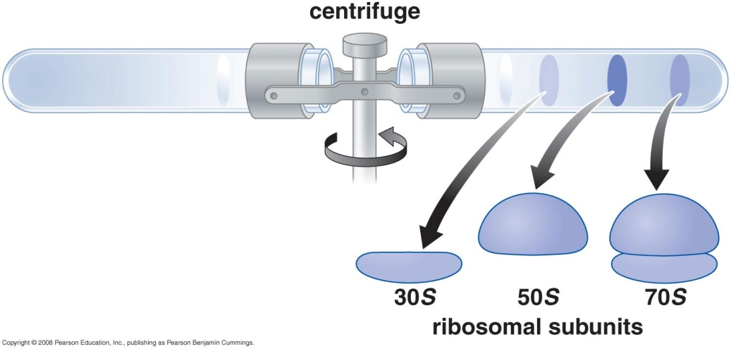
3- Ribosomes
Ribosome is huge machinery ~ 2.5 megadalton
3 rRNA molecules + ~ 50 proteins
Arranged in small & large subunits
Sizes and shape are measured by Svedburge unit (S)
Notes:
In the tube a gradient of sucrose in decreasing order and then different proteins are added, centrifugation is conduced for fixed time and molecules are distributed so that heaviest occurs at the bottom

Slide 23
rRNA genes
Bacterial 16S, 23S, and 5S rRNA genes are typically organized as a co-transcribed operon
In Eukaryotes rRNA genes organized in tandem repeats
In humans ~300–400 rDNA repeats are present in five clusters (on chromosomes 13, 14, 15, 21 & 22).

Slide 24
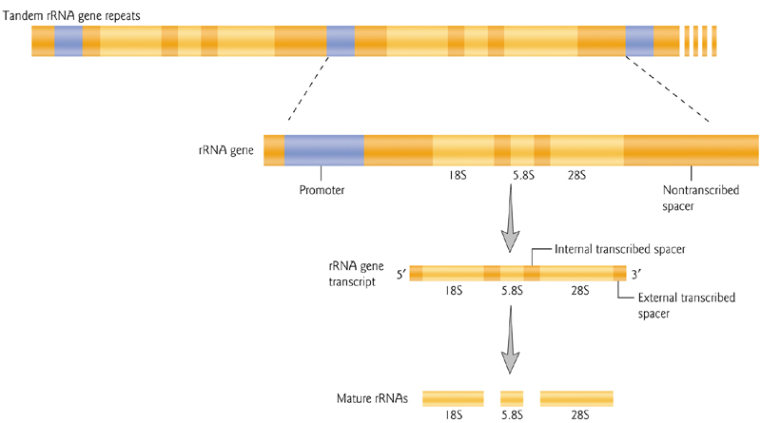
Ribosomal gene transcription in Eukaryotes

Slide 25
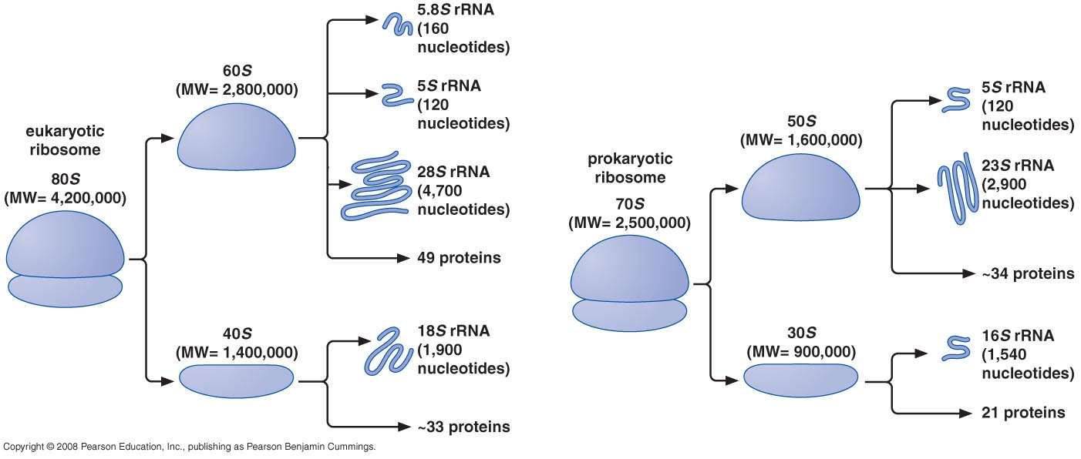
Ribosomal subunits

Slide 26
Ribosomal subunits
Large subunit
  Peptidyl transferase center
Small subunit
  Decoding center
Most of the weight due to rRNA not protein
Function is conducted by rRNA not protein
Proteins responsible to shield negative charges of RNA backbone

Slide 27
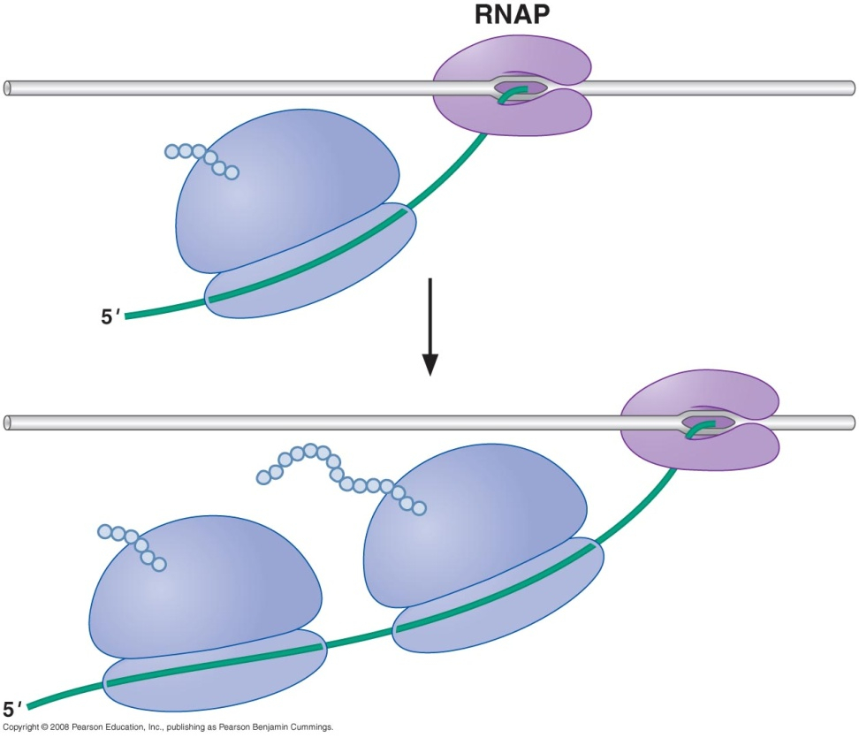
Translation
Prokaryotes
Coupled with transcription
20 aa/sec
Eukaryotes
Separate from transcription
2-4 aa/sec

Slide 28
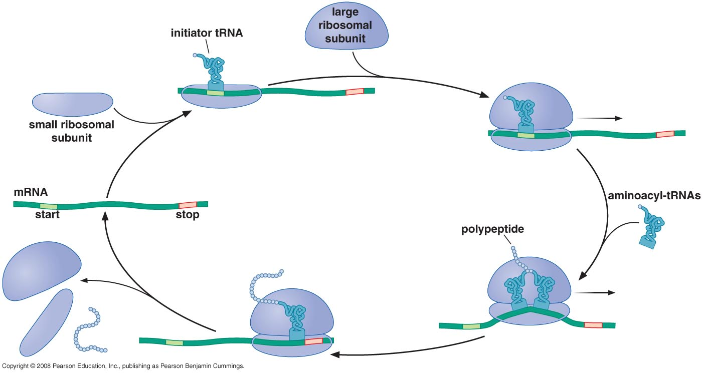
Ribosome cycle
Notes:
It is the association of the small and large subunit with mRNA to translate it and then dissociate when mission accomplished

Slide 29
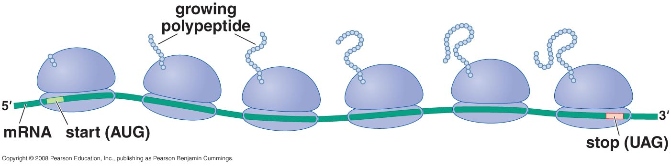
Polyribosome (Polysome)
A ribosome synthesize one polypeptide at a time
1 ribosome / 80 nucleotide in mRNA
mRNA less abundant than ribosome in the cell

Slide 30
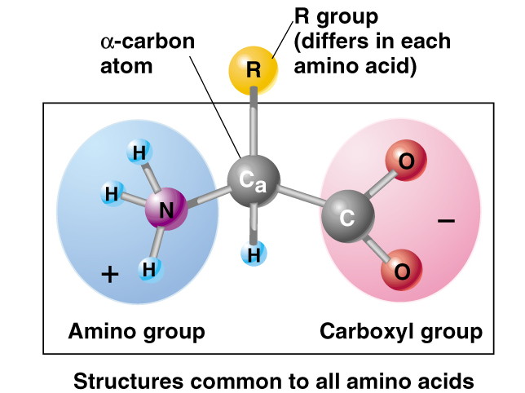
Amino acid structure

Slide 31
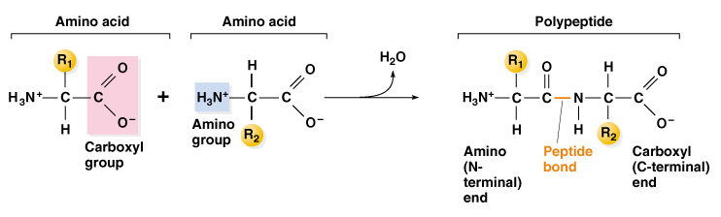
Peptide bond

Slide 32
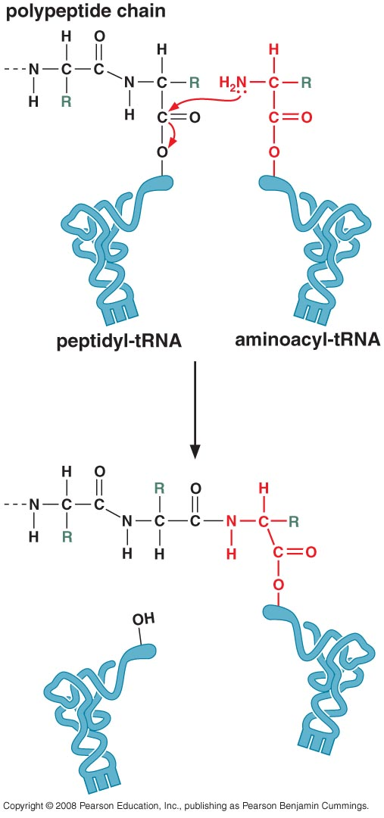
Directions of translation
mRNA has 5`→ 3` direction
Polypeptide:
  New aa added to C-terminus
  has N → C terminal direction
tRNA is attached by 3` end to carboxyl group of aa

Slide 33
Peptidyl transferase reaction
The growing polypeptide chain is always attached to tRNA
Growing peptide chain is transferred from peptidyl tRNA to aminoacyl tRNA
Energy needed for new peptide bond is taken from hydrolysis of tRNA charging reaction

Slide 34
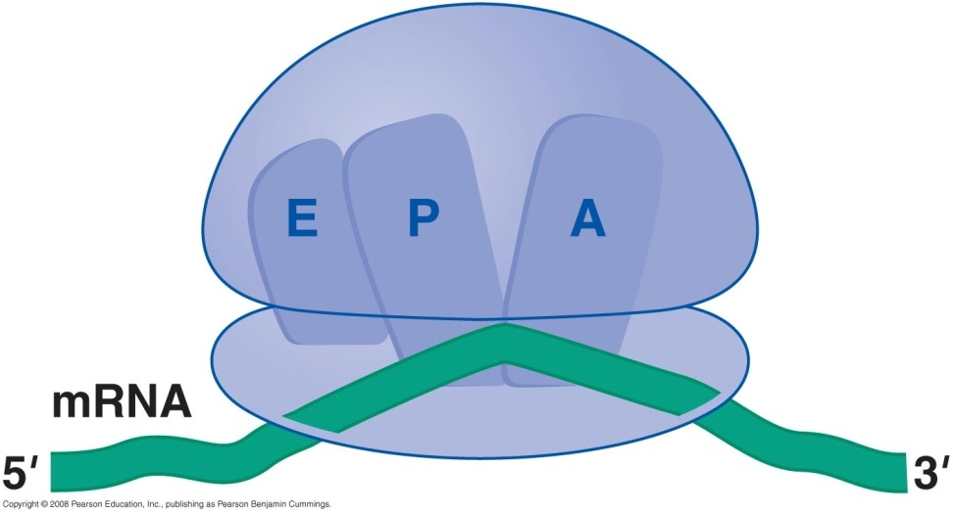
Ribosomes have 3 tRNA binding sites
Binding sites:
  A site: Aminoacylated tRNA
  P site: Peptidyl-tRNA
  E site: site for tRNA to Exit

Slide 35
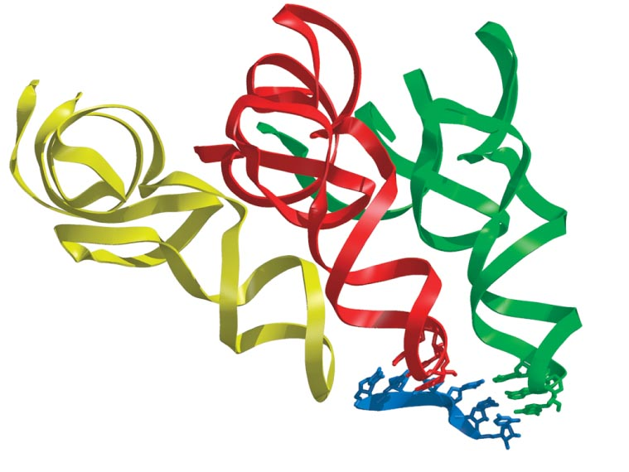
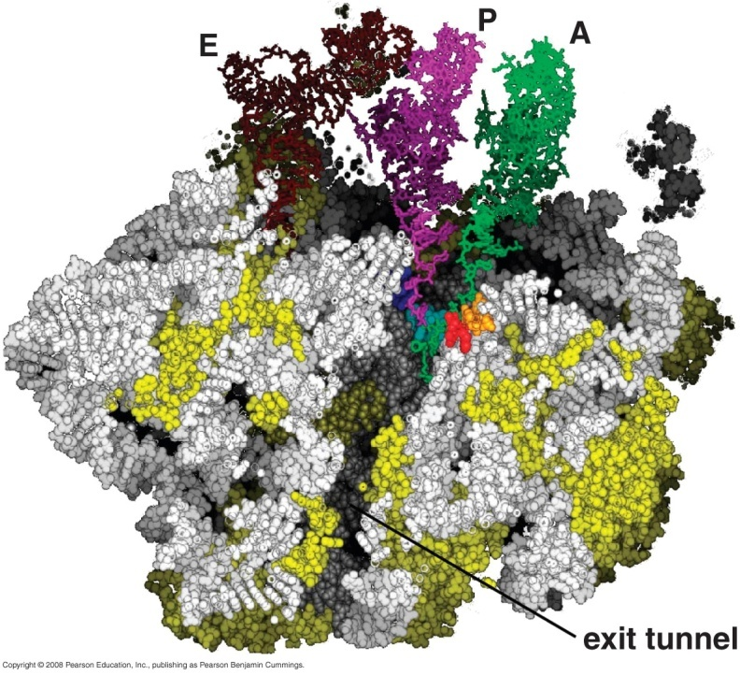
Channels through ribosome
mRNA enters & exit small subunit through channels
Exit channel in large subunit for growing polypeptide
Kink between codons in mRNA

Slide 36
Initiation of Translation

Slide 37
For successful initiation
Initiation is most complex and is the rate limiting step
Initiation in Prokaryotes is different than Eukaryotes

Slide 38
Initiation in Prokaryotes

Slide 39
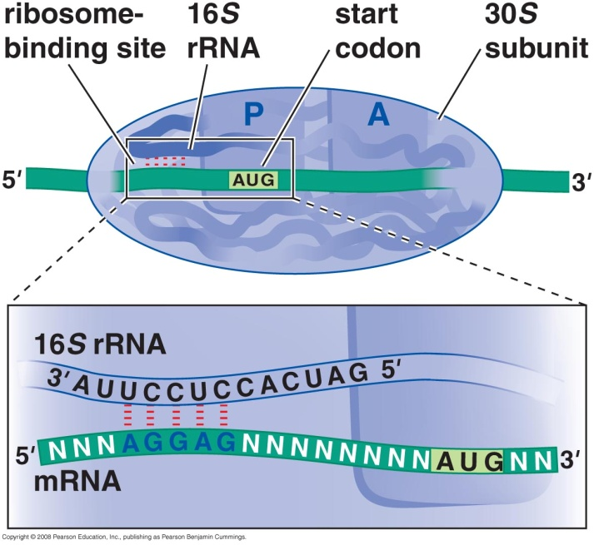
Recruitment of mRNA to rRNA
Binding of small unit with RBS of mRNA
→ Start codon is placed at P site
Large subunit join at the final stage

Slide 40
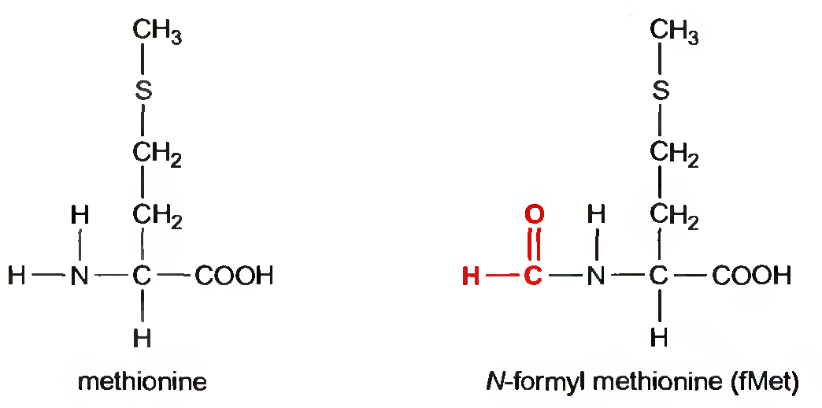
Initiator tRNA
Initiator tRNA is charged with N-formyl methionine (fMet-tRNA_{i}^{fMet})
Deformylase removes formyl group
Aminopeptidase remove methionine from amino terminus

Slide 41
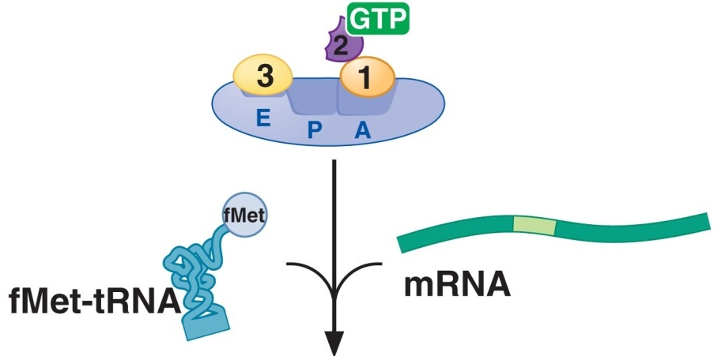
Recruitment of initiator tRNA to P site Translation initiation factors
IF1: prevents tRNA from binding to “A site” in small unit
IF2: is GTPase
  Facilitate binding of initiator tRNA
  Prevents binding of other tRNA
IF3: prevents association with large subunit or tRNA
Notes:
IF3 become associated at the end of first cycle to help removal of 50 S unit and remains there to prevent its re-association and to prevent binding with tRNA at the E site which should remain empty

Slide 42
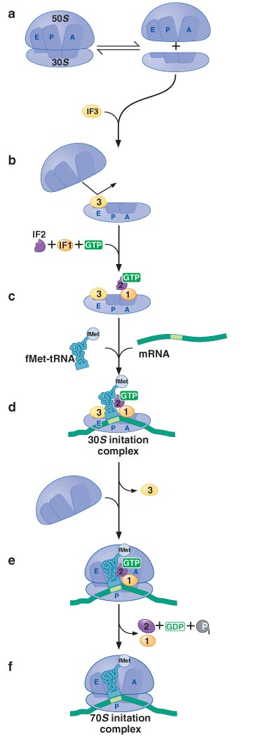
Initiation in Prokaryotes
Anticodon binding of fMet-tRNA_{i}^{fMet} to start codon:
  ensure its localization to P site
  Conformational change release of IF3 → 70S initiation complex
Binding of large subunit → IF2-GDP
Release of all IF

Slide 43
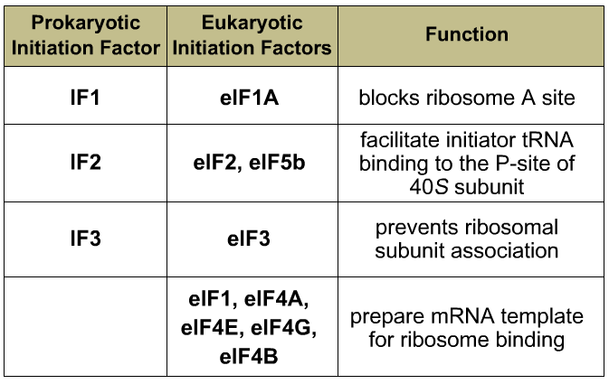
Initiation in Eukaryotes

Slide 44
Initiation in Eukaryotes
No RBS → tRNA^{met} should be bounded to small subunit to scan for start codon
Subdivided into four steps:
Binding of tRNA^{met} to small subunit
Recognition of mRNA
Ribosome + tRNA^{met} scan for start codon (AUG)
Binding of large subunit (80S initiation complex)

Slide 45
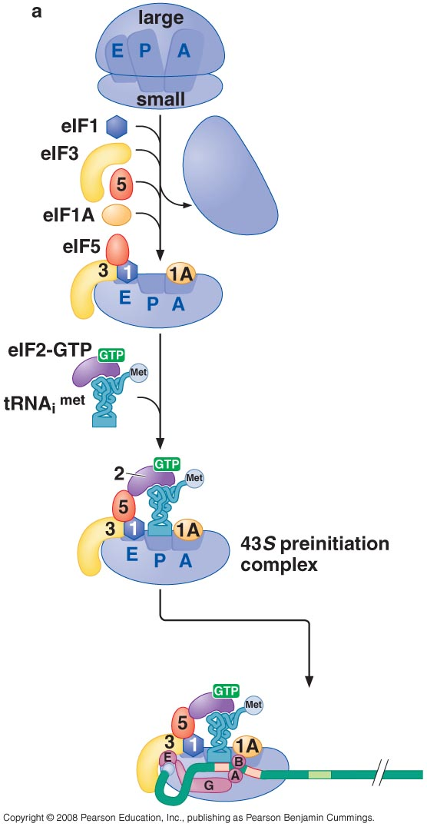
1- Binding of tRNA^{met} to small subunit
eIF1+eIF1A+eIF3+eIF5 binds to small subunit
Ternary complex = eIF2+ GTP + tRNA^{met}
43S preinitiation complex

Slide 46
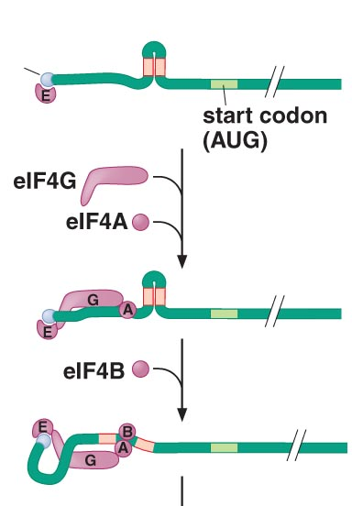
2- Recognition of mRNA
eIF4E recognise 5` cap
eIF4G bind with E + mRNA
Competition between IF4G & (eIF4E binding protein) Regulate translation
eIF4A is a helicase activated by eIF4B

Slide 47
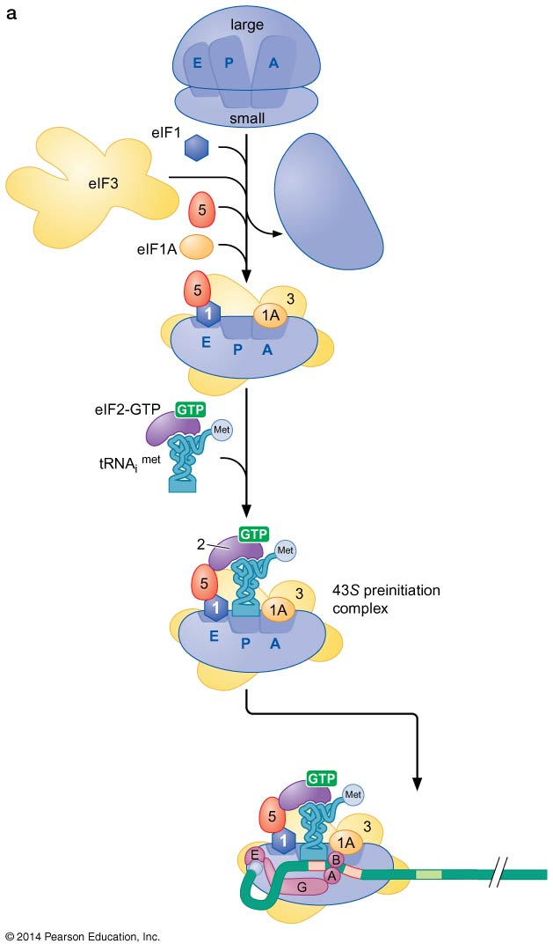
48S preinitiation complex
Notes:
The 43s complex already includes the itRNA before association with mRNA

Slide 48
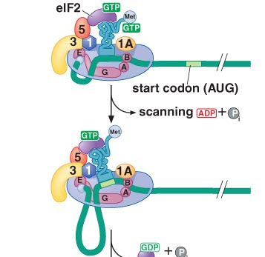
3- Scanning & start codon recognition
Complex move in 5`→ 3` direction
Need ATP
Helicase activity by eIF4A/B
Recognize first AUG in favorable kozak sequence by pairing with tRNAi

Slide 49
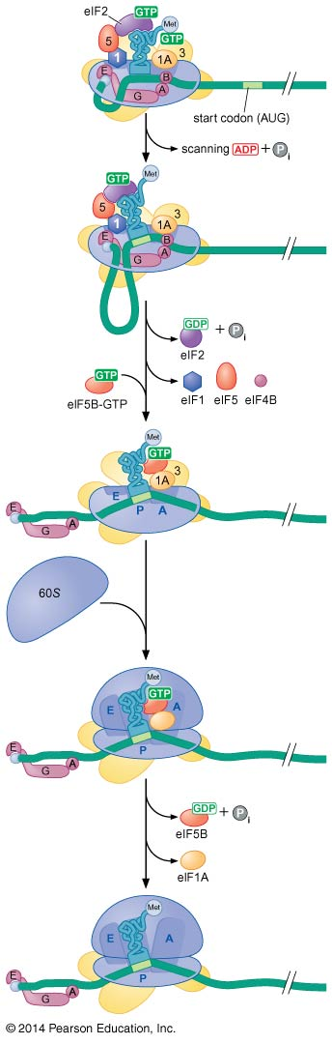
4- Formation of 80S initiation complex
Correct pairing with start codon change eIF5 conformation
↓
Hydrolysis of eIF2-GTP
↓
Leave tRNA^{met}
↓
Release of remaining factors
Recruit eIF5B-GTP
↓
80S initiation complex
↓
eIF5B-GDP

Slide 50
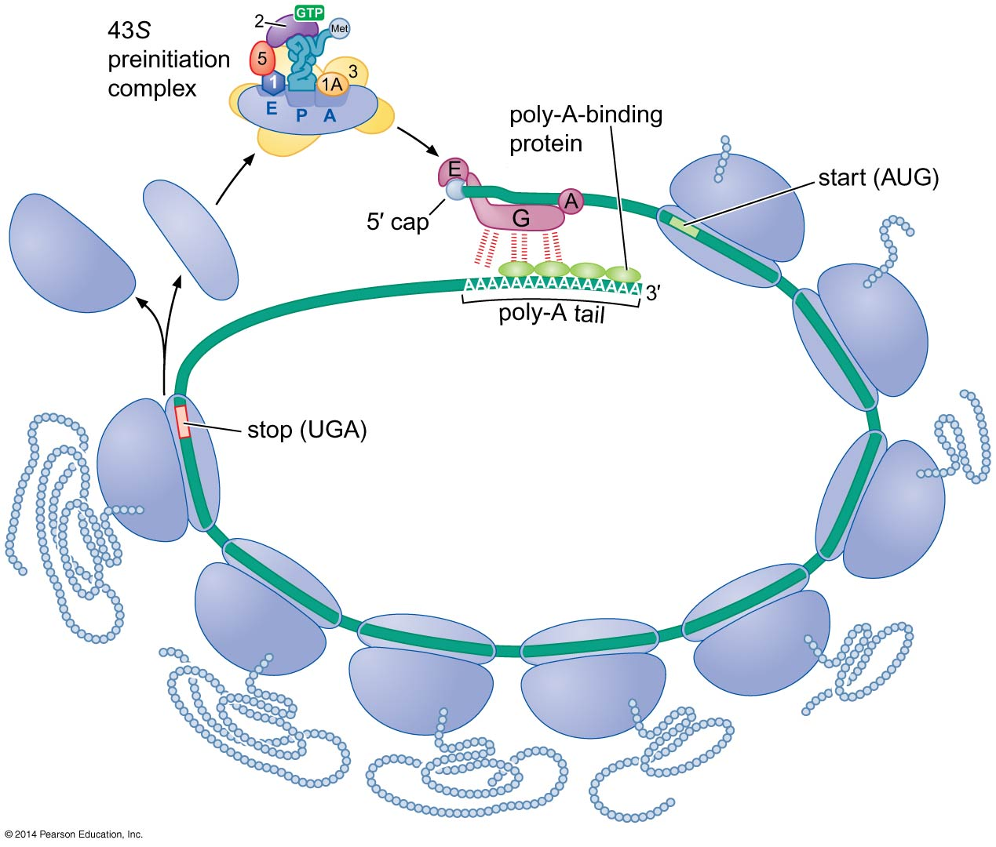
Poly-A tail contribute to efficient translation

Slide 51
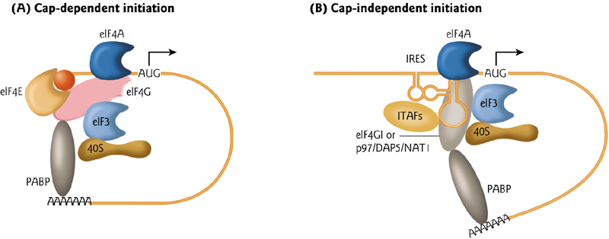
Cap-independent initiation
3-5% of cellular mRNA translated in cap independent manner
Ribosomes are recruited by internal ribosome entry site (IRES)
Needs other trans-acting factor

Slide 52
Translation elongation

Slide 53
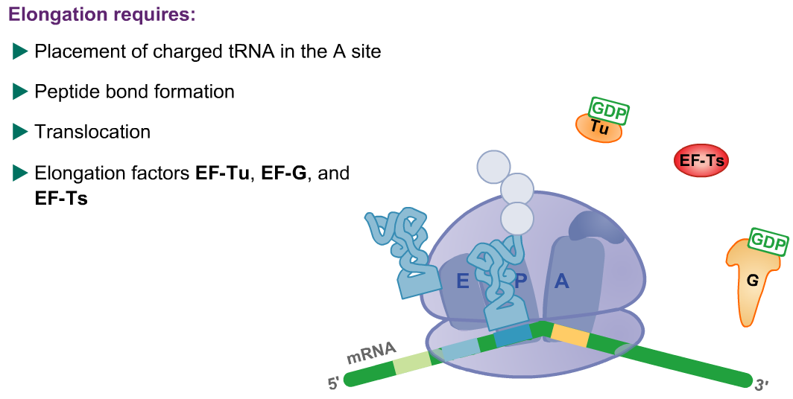
Elongation requires:

Slide 54
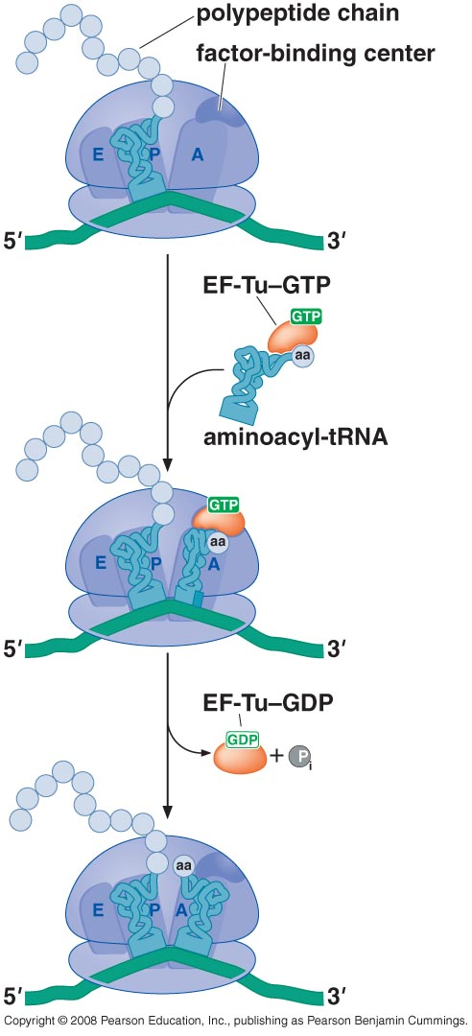
EF-Tu elongation factor
EF-Tu –GTP escort animoacyl-tRNA to A site
Correct codon-anticodon relation → factor binding center hydrolyze GTP

Slide 55
3 mechanisms to ensure correct codon-anticodon base pairing
Adinine residues in 16S rRNA
Interaction with factor binding center to hydrolyze EF-Tu
Being able to tolerate rotation forces during accommodation stage
Notes:
The difference in energy between codon with one mismatch is close to that with correct base pairing so there must be a way to ensure accurate codon-anticodon relationship

Slide 56
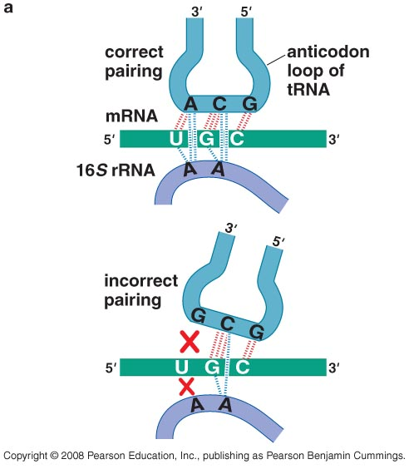
1- Adinine residues
Recognize only correct /incorrect pairing
Interact with minor groove of correctly based paired nucleotides

Slide 57
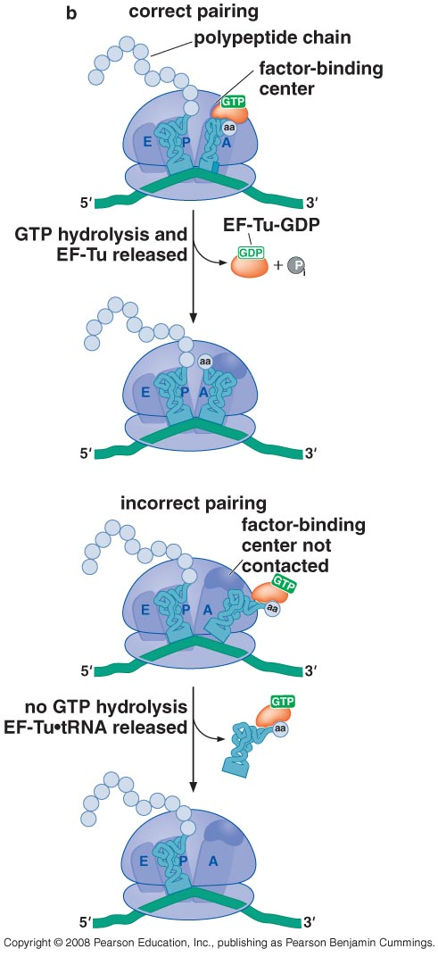
2- hydrolysis of EF-Tu GTP

Slide 58
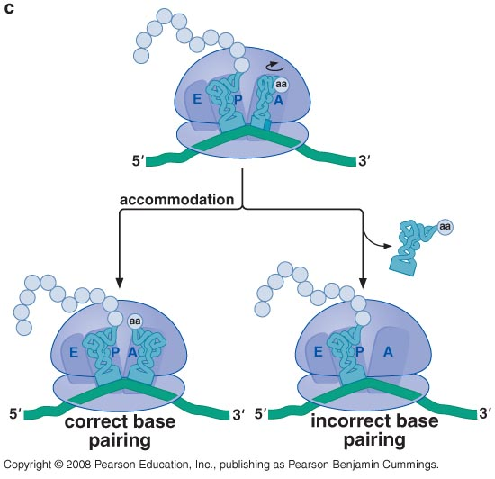
3- tolerate forces during accommodation
Accommodation: rotation of tRNA in A site toward P site for peptidyl transferase reaction
Incorrect base pairing causes dissociation of tRNA during accommodation

Slide 59
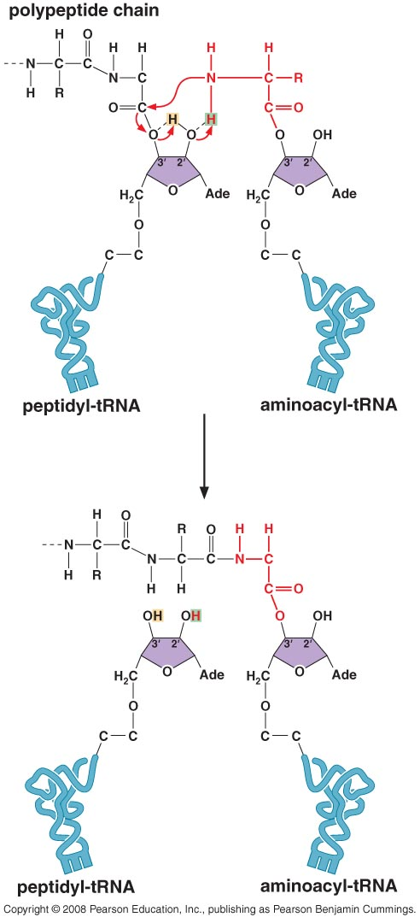
Formation of the peptide bond
rRNA is mostly responsible for catalyzing peptid bond, L27 protein only contribute in the process
  “Entropic catalysis”: base pairing of 23rRNA & CCA of tRNA bring 2 aa together
  “Substrate assisted catalysis”, 2`-OH of terminal A acts as “proton shuttle”

Slide 60
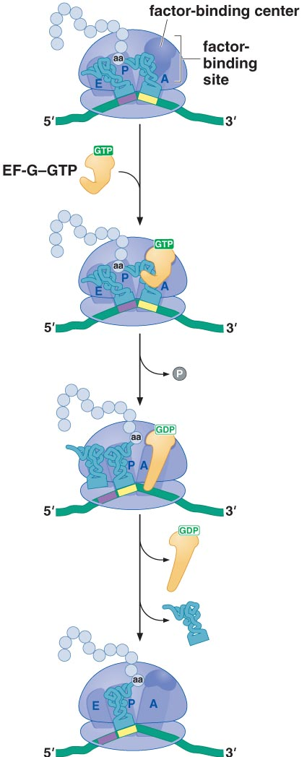
translocation
Hybrid State: Tips of tRNA in A & P sites are in P & E sites respectively
EF-G is needed to complete translocation
Factor binding center hydrolyze EF-G-GTP
mRNA move along with tRNA → 3bp shift
Changes in the structure of small rRNA occurs to allow translocation

Slide 61

Molecular mimicry
tRNA+EF-Tu-GTP EF-G-GTP

Slide 62

Recycling of EF
GTP exchange factor (EF-Ts) remove GDP →
GTP binds to EF-Tu - EF-Ts complex

Slide 63
Energy cost
1 ATP for peptide bond
1 GTP for EF-Tu to escort tRNA to A site
1 GTP for EF-G for translocation
1 ATP + 2 GTP / aa

Slide 64
Termination of Translation

Slide 65


Release factors terminate translation
Stop codon is recognized by protein called release factors (RF)
Two classes of RF

Slide 66

Class I release factor
Recognize stop codon & hydrolyze polypeptide chain
Peptide anticodon region
  3 amino acids recognize stop codon
  Located in decoding center
GGQ region
  Conserved region
  Located in peptidyl transferase center
  Contribute to polypeptide chain hydrolysis

Slide 67

Class II release factor
Remove RF1 from ribosome
Only recruited when PP chain is released
RF1 + rRNA exchange GDP by GTP

Slide 68
Class II release factor
RF3-GTP removes RF1
RF3-GTP interact with factor binding center →
RF3-GDP →
Released from ribosome

Slide 69

Ribosome recycling
Ribosome recycling factor (RRF)
EF-G (elongation factor)
IF3 (initiation factor)
Mimic the shape of tRNA
Removes tRNA directly from P site (no translocation)

Slide 70

Eukaryotic Translation Termination and ribosome recycling

Slide 71
Regulation of Translation

Slide 72
Why regulation is needed at translation level
For quick response to external stimuli
Usually at the initiation stage
  More effective
  Eliminate production of incomplete proteins
Notes:
Most genes are regulated at level of transcription

Slide 73


Regulation of translation initiation in Bacteria
Regulation is achieved in 2 ways
RNA binding proteins
  Bind to sequences close to RBS NOT RBS itself
  Interferes with recognition of RBS by 30S
mRNA folding

Slide 74
Example: control of ribosomal protein synthesis
Amount of ribosomal proteins synthesized is coordinated to rRNA
Ribosomes synthesized are coordinated to growth rate
Inserting extra operons of ribosomal proteins would not increase amount of ribosomal proteins synthesized

Slide 75

E. coli Ribosomal protein operons
Notes:
Figure 15-43

Slide 76

Control by autorepression
Control by translational coupling

Slide 77


Ribosomal protein S8 binds 16S rRNA and its own mRNA

Slide 78
Global Regulators of Eukaryotic translation
During stresses or starvation the cell needs to reduce protein synthesis generally (globally)
Two steps of initiation are targeted for inhibition:
  Binding of tRNA_{i} to 40S subunit
    Gcn2 protein kinase phosphorelate eIF2
    prevent eIF2B (GDP exchange factor) action
  Recognition of mRNA

Slide 79

Global Regulators of Eukaryotic translation
mTor kinase inhibitor is used as chemotherapy

Slide 80

Spatial control of translation by mRNA specific 4E-BPs
Oskar mRNA is synthesized by cells in the ovary of mother fly and localized anteriorly
Oskar protein should be present posteriorly
Notes:
Figure 1. Translational regulation of oskar mRNA during Drosophila melanogaster oogenesis.
(a) Developing oocyte (large cell on the right) in the egg chamber. The localization pattern of oskar mRNA (blue) and Oskar protein (red) is shown. Transcripts are packaged into particles that exclude ribosomes but are approximately the same size as 80S ribosomes when fractionated on a sucrose density gradient. 80S surface calculated from PDB entries 1S1H and 1S1I16. (b) Silencing particles contain Cup, Bruno and oskar mRNA. It remains formally possible that the particles contain messages where interactions between eIF4E (pink; PDB entry 1EJ1)17, Cup (blue) and Bruno (purple) link the BRE sequences in the 3' UTR (green) to the 5' cap structure, consistent with the prevalent repression model. It is unknown whether silenced mRNA in the particles contains a poly(A) tail (thin black line) and poly(A)-binding protein (light blue; PDB entry 1CVJ)18.

Slide 81

Spatial control of translation by mRNA specific 4E-BPs
Only oskar mRNA is targeted by presence of Bruno response element
Cup protein includes 4E-BP domain

Slide 82

Iron-regulated, RNA-binding protein controls translation of ferritin
Ferritin controls Fe level in the body
Ferritin translation is regulated by iron regulatory proteins (IRPs) that recognize iron regulatory element

Slide 83

Iron-regulated, RNA-binding protein controls translation of ferritin
Iron regulatory protein recognize ferritin mRNA by hairpin iron regulatory element

Slide 84
Control of translation in yeast
Gcn4 is a transcriptional activator for genes encoding enzymes for aa biosynthesis
  Low aa level → Gcn4 is translated → ↑ biosynthesis
  High aa level → Gcn4 not translated → ↓ biosynthesis
  How is Gcn4 level regulated?
Gcn4 mRNA has 4 ORF upstream of coding sequence (uORFs)

Slide 85

Control of translation in yeast
(eIF2B)

Slide 86

Control of translation in yeast
(eIF2B)
Notes:
uORF1 has a specificity that in 50% of cases it allows the S40 subunit bounded to mRNA scaning for new start codon

Slide 87
Protein folding
Takes place:
  Before the completion of protein synthesis on ribosome
  After release form the ribosome
    Cytoplasm
    Specific compartments (mitochondria, ER)
Molecular chaperones are needed for proper folding
Misfolded proteins are targeted for degradation
Accumulation of misfolded protein is associated with human disease
Notes:
Prion causing cow mad disease, other diseases caused be protein misfolding include Alzheimer, Parkinson, type 2 diabetes

Slide 88
Regulation of protein activity by post-translational modifications
After translation proteins are attached with other molecules (metal, lipid, carbohydrate,…)
Post-translational modification have a structural and regulatory effect
  Reversible Phosphorylation
    kinases (specific)
    phosphatase (non-specific)
  Allosteric regulation

Slide 89

Protein phosphorylation

Slide 90

Allosteric regulation

Slide 91
Defective mRNA
No stop codon
  Frame shift
  Incomplete transcription
  mRNA degradation
Premature stop codon
Change in codon sequence → change in one aa
Premature of lack of stop codon bring translation machinery to halt

Slide 92

Eliminating defective mRNAin Prokaryotes
Chimeric RNA tmRNA (SsRA RNA)
Recruited only when no mRNA is present
457 nucleotide
Resemble tRNA^{Ala}
mRNA is released
Polypeptide produced is attached to 10 aa “tag”
Ribosome is recycled

Slide 93

Normal translation in Eukaryotes

Slide 94

Nonsense mediated mRNA decay

Slide 95


Nonstop mediated decay

Slide 96

No-go-mediated mRNA Decay

